Slide 1
Reinforcement Learning
Week 1

Slide 2
Some logistics before we start
Meetings weekly on Thursday 4-5pm hybrid
Lecture/Notebook
Slides/Notes will be posted before hand so no typing is involved

Slide 3
Rough Timeline
Week 3-5
Week 6-8
Week 9
Week 10
Focus on RL content. We will cover introductory RL topics and play with libraries such as OpenAIGym
Collaborate or work individually on a introductory RL project
Rehearse and finalize presentations
Present!

Slide 4
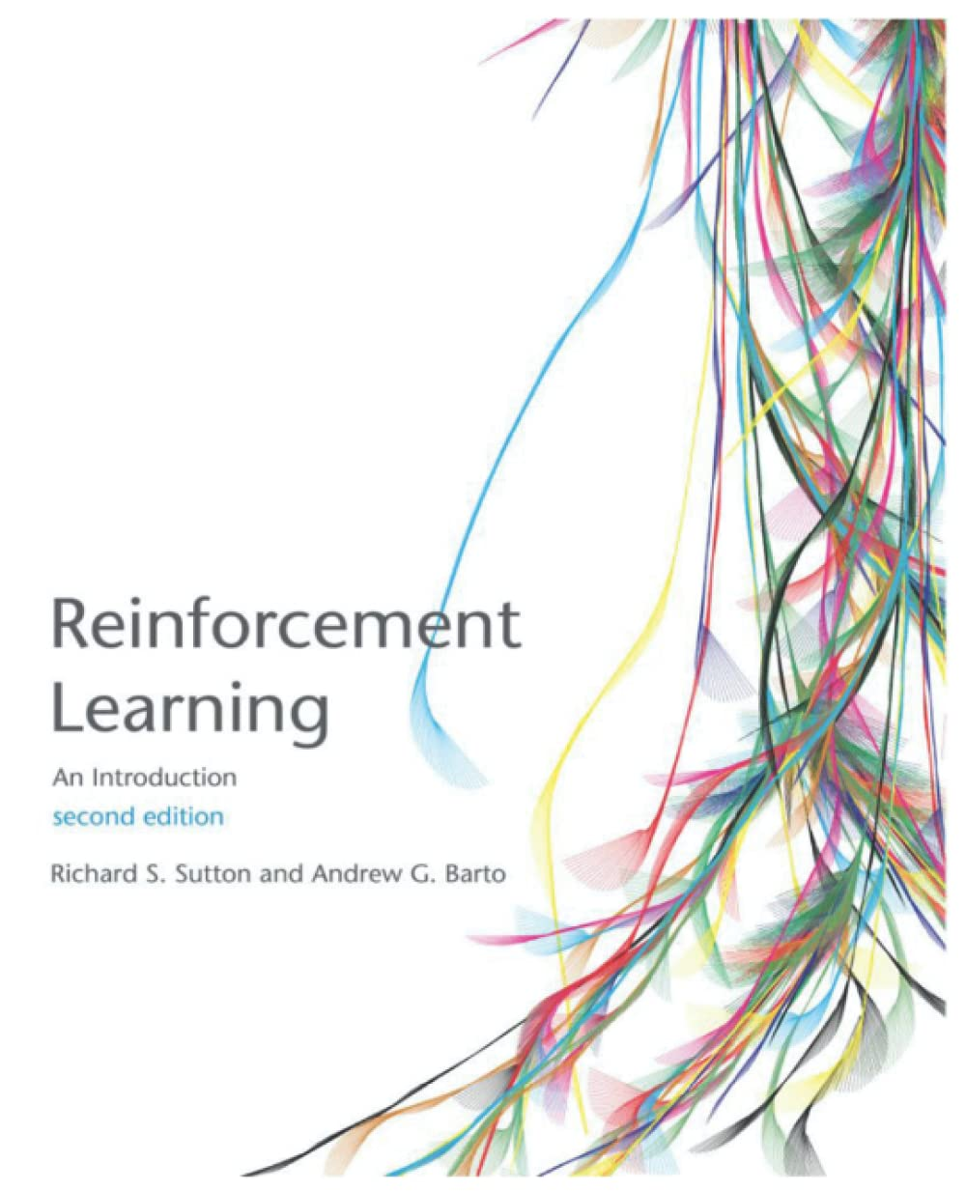
Textbook to follow
LINK TO PDF

Slide 5
Any Questions?

Slide 6
Topics Today
What is RL?
Framework of RL
MDP
Policies and Value Functions

Slide 7
What is Reinforcement Learning?
Reinforcement learning describes how a learner(agent), tries to learn how to make good decision under uncertainty.

Slide 8
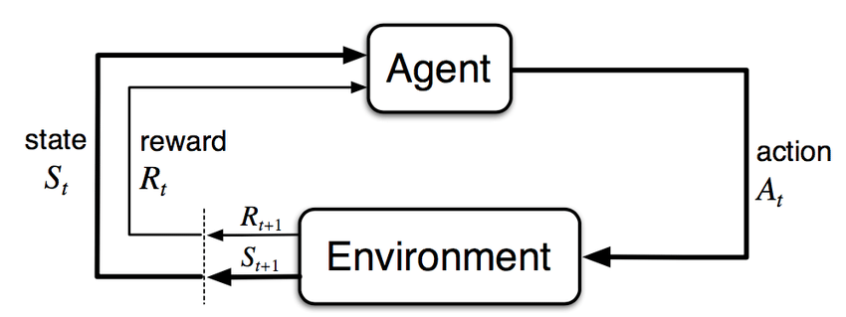
RL Framework

Slide 9
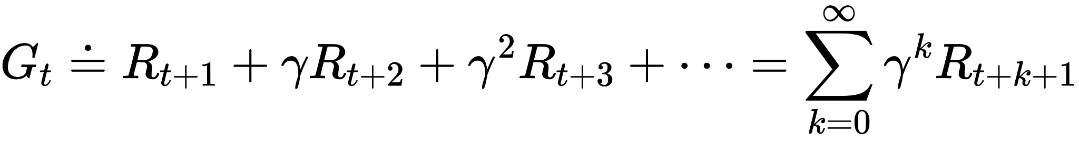
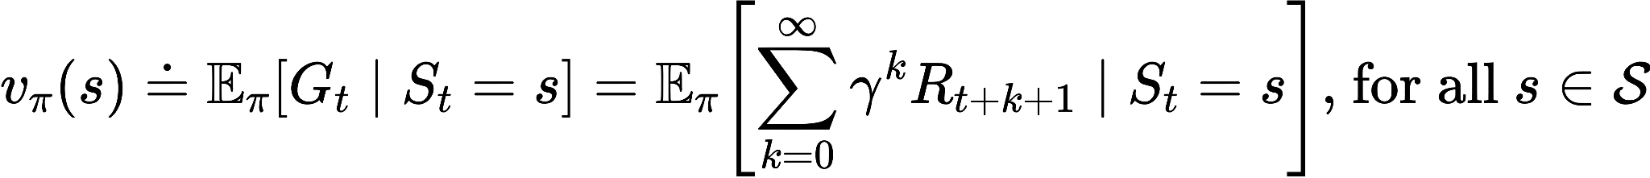
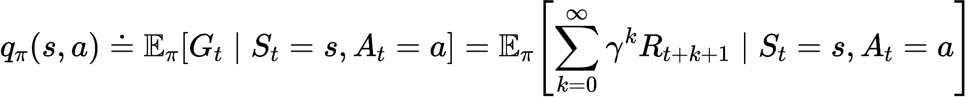
Some Important Equations
Dynamic Equation
Discounted Return
Value Function
Action-Value Function
Bellman Equation for Value Function

